Slide 1


Slide 2
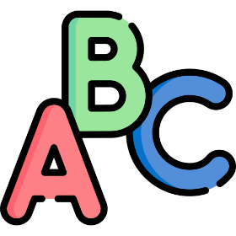
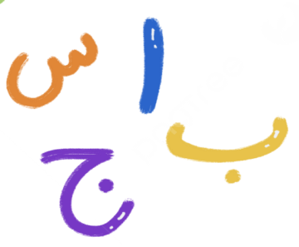


ALPHABETICA

Slide 3
Group Information
Superviesed By
Aktaruzzaman | ID: 21222203031 | Sec - 01 | Intake - 41
Siam Hossain | ID: 21222203037 | Sec - 01 | Intake - 41
Md. Najmul Parves | ID: 21222203005 | Sec - 01 | Intake - 41
Md. Abdullah Al Mamun | ID: 21222203017 | Sec - 01 | Intake - 41
Md. Naim Hoshain Pranto | ID: 21222203030 | Sec - 01 | Intake - 41
Md. Mahbubur Rahman
Assistant Professor, CSE, BUBT

Slide 4
Table of Contents
01 | Problem Statement | 05 | Diagram and Flowchart
02 | Features | 06 | App Preview
03 | Technology Used | 07 | Conclusion & Limitation
04 | System Requirements

Slide 5
01
Problem Statement

Slide 6
Interactive Alphabet Learning
Problem: Limited interactive tools for learning alphabets in different languages. Solution: Create an app with audio pronunciation, visual feedback, and language-specific modules.
State Persistence for User Preferences
Problem: Loss of last selected state disrupts learning continuity. Solution: Use SharedPreferences to save and restore user preferences.
Multi-Language Alphabet Accessibility
Problem: Limited resources for learning Bengali, Arabic, and English alphabets with correct pronunciation. Solution: Create language-specific modules with audio for accurate pronunciation and structured content.

Slide 7
02
Feature

Slide 8
Bengali Learning Modules | English Learning Modules | Arabic Learning Modules | Interactive Mathematics Game
Bengali vowels (স্বরবর্ণ) Bengali consonants (ব্যঞ্জনবর্ণ) Bengali numbers (১-১০) | English alphabet (A-Z) English numerical (1-10) | Arabic alphabet (ي أ-) Arabic numerical (1-10) | Engaging math exercises for users to enhance problem-solving skills.

Slide 9
03
Technology Used

Slide 10
Operating System | Ubuntu 24.04
Hardware | 16 GB RAM, Intel Core i7 (7th Gen)
Programming Language | Java (Version 20 with JDK 20)
IDE | Android Studio
Database | SQLite
Libraries | MediaPlayer: For interactive audio playback- CountDownTimer: For math game timer- SharedPreferences: To store and manage user data locally

Slide 11
04
System Requirements

Slide 12
Device | Android smartphone or tablet
Processor | Minimum 1 GHz
RAM | 2 GB or higher
Storage | 150 MB or higher
Operating System | Android 5.0 (Lollipop) or later

Slide 13
05
Diagram and Flowchart

Slide 14
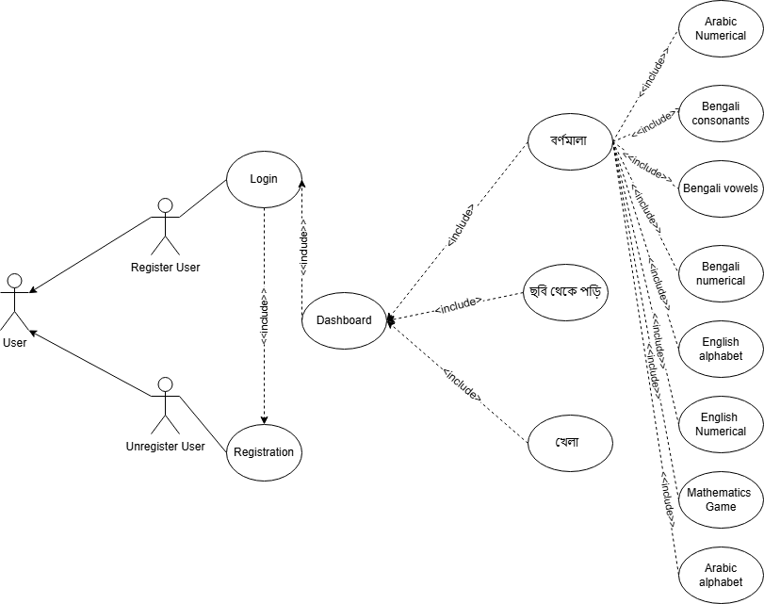
Use Case Diagram

Slide 15
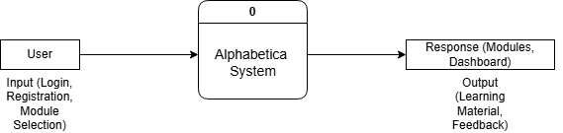
LEVEL 0 DFD

Slide 16
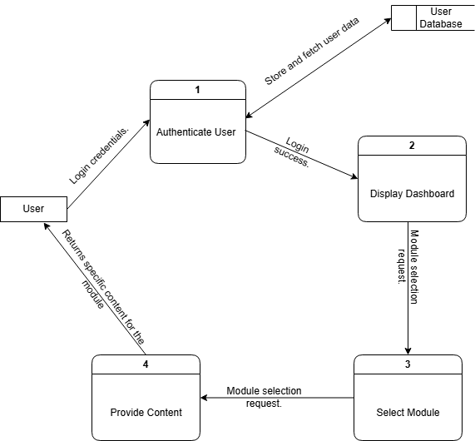
LEVEL 1 DFD

Slide 17
User Table
Column Name | Data Type | Constraints | Description
fullname | TEXT | NOT NULL | Stores the user's full name.
Email | TEXT | NOT NULL | Stores the user's email.
username | TEXT | UNIQUE, NOT NULL | Stores the user's unique username.
password | TEXT | NOT NULL | Stores the user's password.

Slide 18
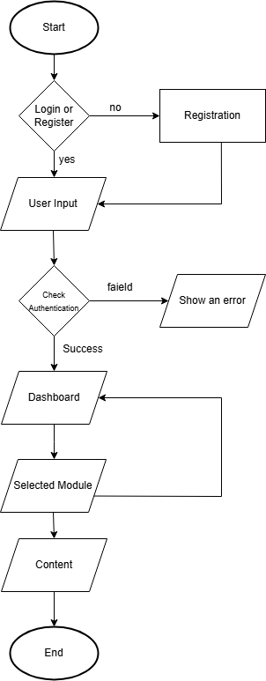
Flowchart

Slide 19
06
App Preview

Slide 20
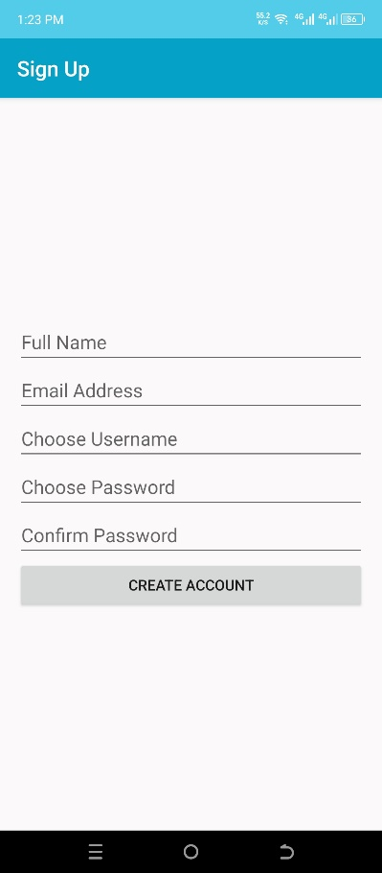
User Registration

Slide 21
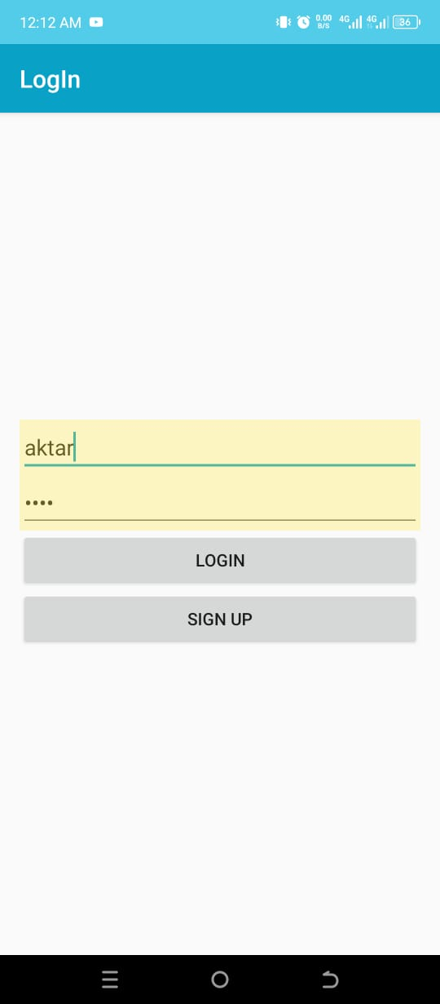
User Login

Slide 22
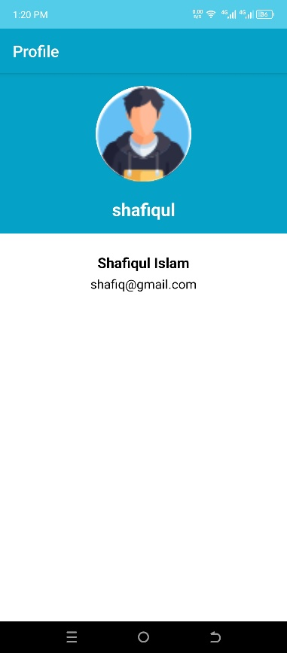
Profile

Slide 23
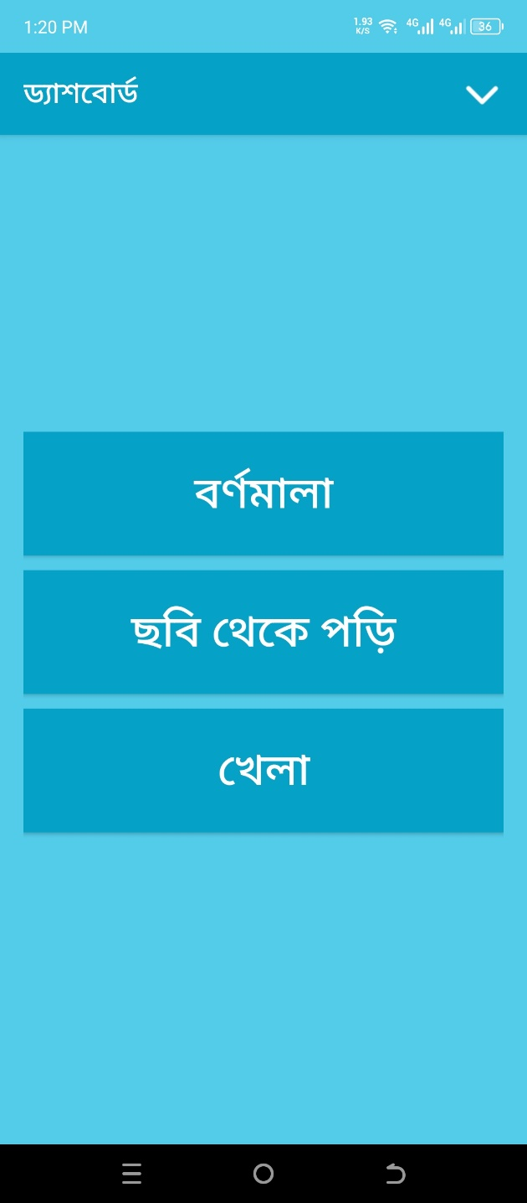
Dashboard

Slide 24
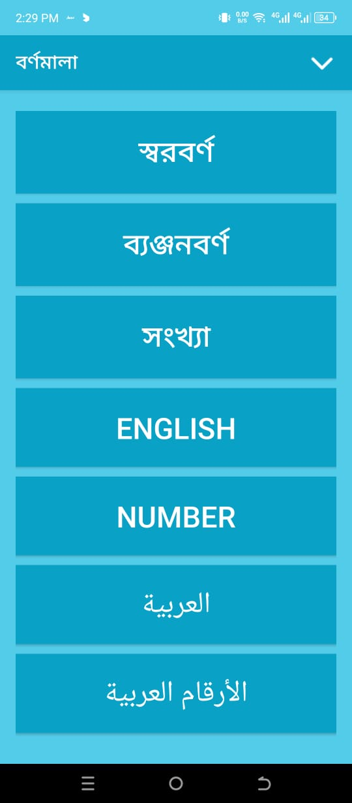
বর্ণমালা Dashboard

Slide 25
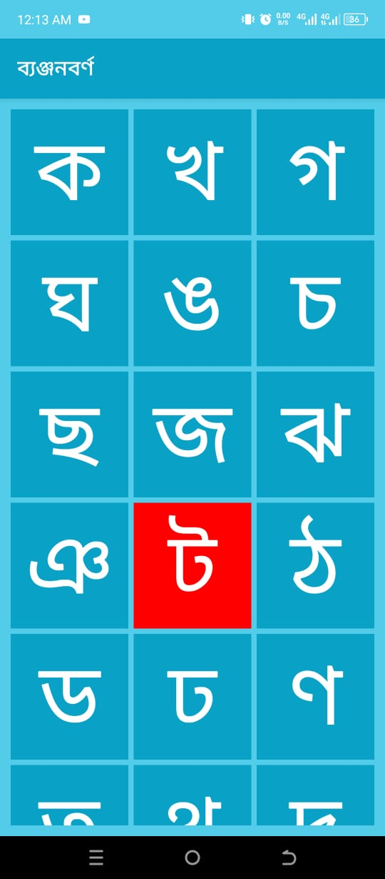
ব্যঞ্জনবর্ণ Module

Slide 26
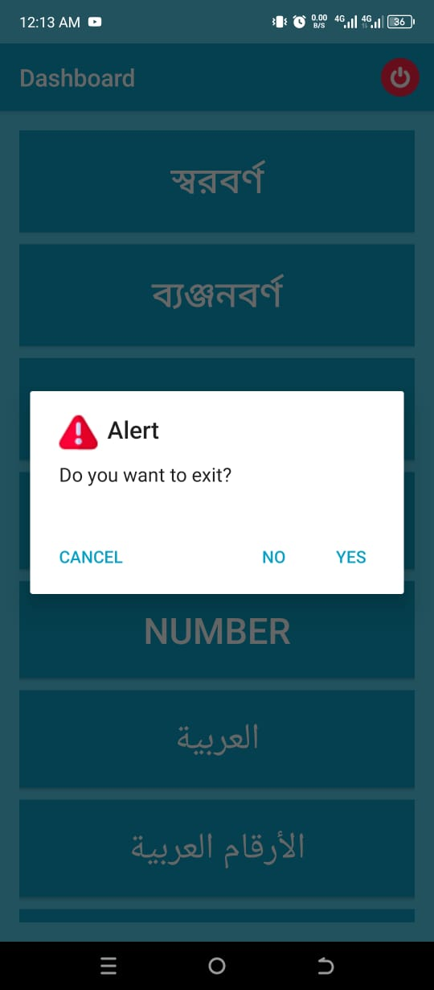
Alert Dialogue Box
For Closing App

Slide 27
After closing back
to ব্যঞ্জনবর্ণ Module

Slide 28
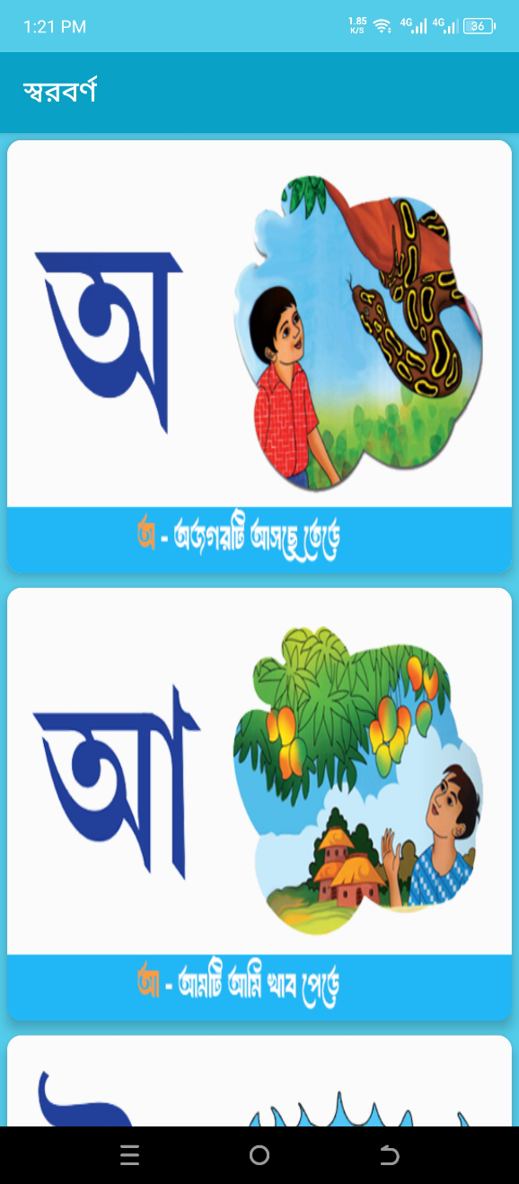
ছবি থেকে পড়ি স্বরবর্ণ
Module

Slide 29
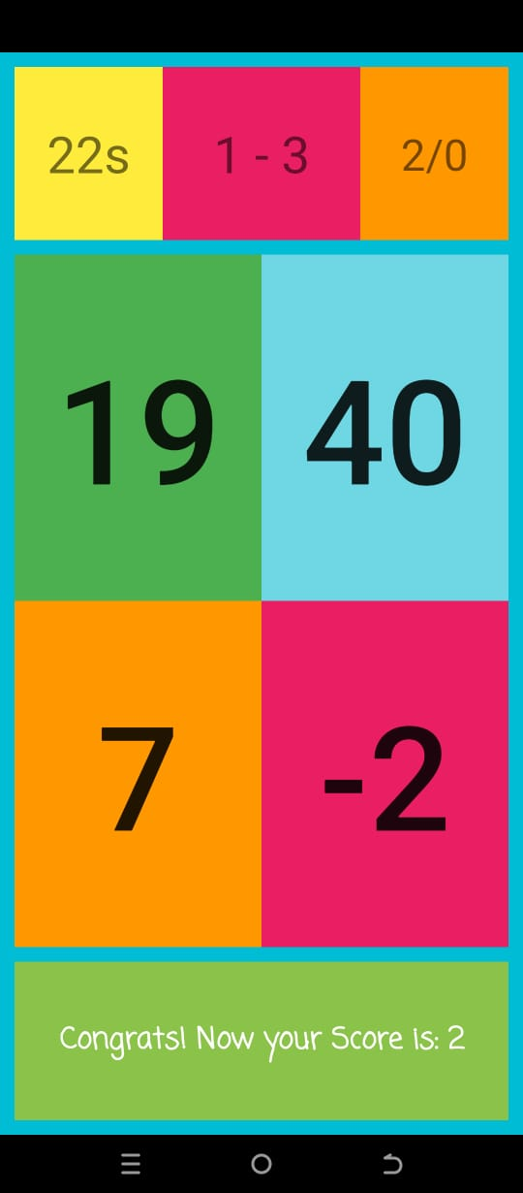
Game Module

Slide 30
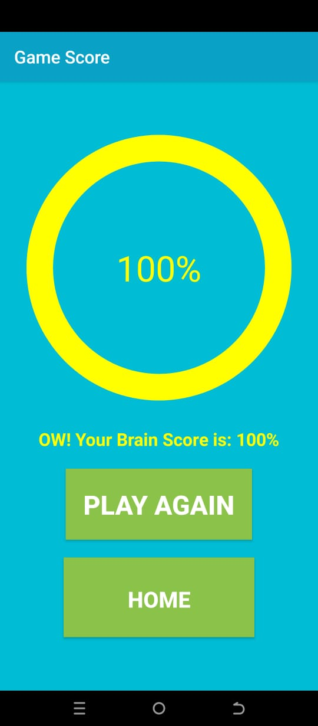
Game Score

Slide 31
07
Conclusion & Limitation

Slide 32
Conclusion
Interactive Learning: The app provides an engaging platform to learn Bengali, English, and Arabic alphabets and numbers.
Tailored Content: Includes audio pronunciations, visual feedback, and structured language modules.
State Persistence: SharedPreferences ensure seamless user experience by saving the last state.

Slide 33
Limitation
Language Support: Currently supports only Bengali, English, and Arabic.
Audio Quality: Limited to pre-recorded pronunciations, which may not cover all accents.
Platform Dependency: Only available on Android, not on iOS or web platforms.

Slide 34
Thanks!
Do you have any questions?

